Slide 1
DEPARTMENT OF COMPUTER SCIENCE
GEOGRAPHICAL INFORMATION SYSTEM (GIS)
SCS3204
LECTURER 2
INTRODUCTION TO GIS
BY
Dr. Fredrick Kanobe (Ph.D)
Tel contact: 0782-592120 Emails: fkanobe@kyu.ac.ug or fred.Kanobe@gmail.com

Slide 2
IMPORTANCE OF GIS IN REAL LIFE SITUATIONS
A GIS is also particularly useful at displaying spatial data and reporting the results of spatial analysis. GIS technology can be used compare the locations of different things in order to discover how they relate to each other. For example, using GIS, a single map could include sites that produce pollution, such as factories, and sites that are sensitive to pollution, such as wetlands and rivers.
GIS is essential tool in government and security organisations. It is a powerful tool used in fighting crime. Using GIS technology, security experts can easily trace thieves in their hiding locations
GIS regularly help in the day-to-day management of many natural and man-made resources, including sewerage, water, power, and transportation networks.
GIS allow us to analyze the relative spatial location of important geographic features. Spatial analyses in a GIS may aid in ensuring sustainable recreation, environmental protection, and other benefits
GIS help us identify and address environmental problems by providing crucial information on where problems occur and who are affected by them. GIS help us identify the source, location, and extent of adverse environmental impacts, and may help us devise practical plans for monitoring, managing, and mitigating environmental damage.

Slide 3
GIS can be used in the location of viable remnant plant and animal populations relative to current and future human land uses . Analysis of such information is helpful in planning for continued survival of such species.
GIS of recently has become an important tool used emergency services, flood protection, disaster assessment and management. It can be helpful in the location and identification disaster victims. The GIS matches the address to the nearest emergency service station, a route is then immediately generated based on the street network and traffic, and emergency crews dispatched from the nearest station. It can also be used to land mark disaster incidents and threats that form early warning systems in disaster management.
GIS hospitals and government transport functions. For example emergency vehicles such as ambulances in developed world commonly dispatched and routed using GIS.
GIS may be used to document change, mitigate damage, and effectively manage our natural resources. For example GIS images can be used to track eruptions of mountains and such data cab be used in planning evacuation of affected people and mapping of the damages caused.
Many businesses adopt GIS for increased efficiency in the delivery of goods and services. Retail businesses locate stores based on a number of spatially related factors.
GIS aid telecommunication companies to track fraud teams in mobile money payments in various locations basing on the provided coordinates.

Slide 4
Global Navigation Satellite Systems (GNSS), is now incorporated into cars, planes, boats, and trucks to guide people find shortest routes, avoid traffic and reach their final destinations in time.
GIS may aid in disaster assessment and recovery. Emergency response and longer term rebuilding efforts may be improved by spatial data collection and analysis
Images taken from aircraft and satellites provide a rich source of data, which may be Interpreted and converted to information that can be used in research and other studies
GIS are also widely used in planning and development. Spatial information about villages, town and cities can be used as source of information for planning and development of a country. Such information may include water sources, sewerage, mean of transport, banks, schools, universities etc.
GIS help the government in property records management and taxation. For example GIS can be used to locate various houses and their owners in a city upon which taxes can be determined.
GIS are widely used to improve public health. Air pollution is a major cause of sickness and death. GIS can be used to locate and map air pollution points in a community. Analysis of such information by public health experts results in improvement of the public health of the people.

Slide 5
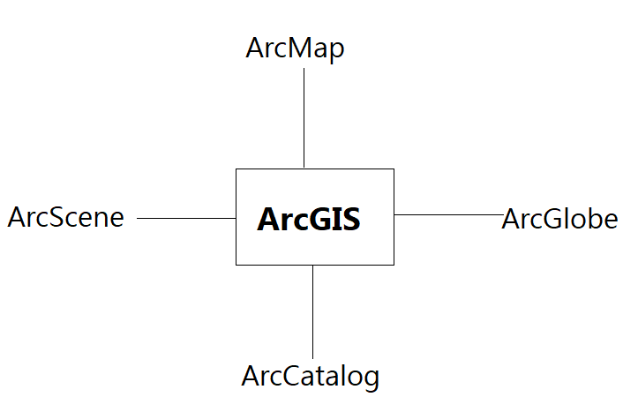
ARCGIS DESKTOP APPLICATION
ArcGIS Desktop software is comprised of a set of integrated applications, which are accessible from the
Start menu of your computer. These include:

Slide 6
1. ARCMAP
ArcMap is the central application used in ArcGIS. ArcMap is where you display and explore the datasets for your study area, where you assign symbols, and where you create map layouts for printing or publication. ArcMap is also the application you use to create and edit datasets.
Functions of ArcMap
Work with maps - exploring information, navigate around your map documents, turn layers on and off, query features to access the rich attribute data that is behind the map.
Print maps —Maps can be printed using arcmMap
Compile and edit GIS datasets – Provides functions for editing your map documents and making updates
Analysis - Arcmap can be used querying or analysis of GIS data and automating some tasks
Organizing your documents - ArcMap includes the Catalog window that enables you to organize all of your GIS datasets and geodatabases, your map documents and other ArcGIS files, your geoprocessing tools, and many other GIS information sets
Publish maps - ArcMap provides a simple user experience for publishing your map documents as map services using ArcGIS Server or ArcGIS Online.
Share maps with other users —ArcMap includes tools that make it easy to share GIS datasets with other users.

Slide 7
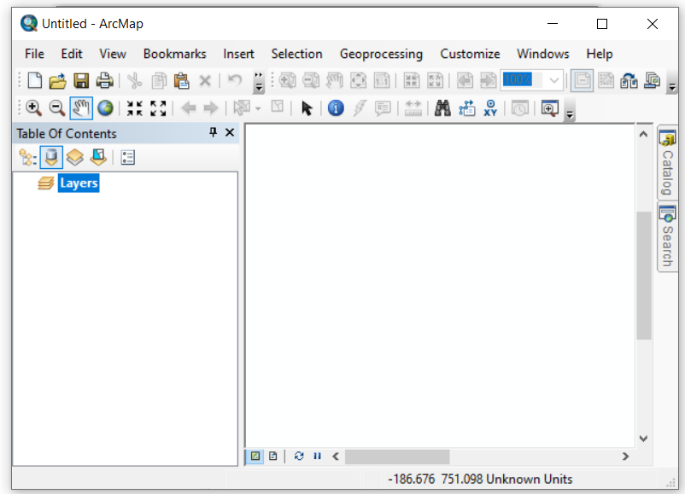
How to open ArcMap
Click the Start button on the Windows taskbar.
Point to Programs.
Point to ArcGIS.
Click ArcMap.
New ArcMap Screen

Slide 8
Common types of Files used in ArcMap
Geodatabase – Geodatabases define, manage, process and store all the types of data that can be used in ArcGIS (i.e., feature, rasters, relationships, measurements, attributes, etc) inside either a Microsoft Access database (.mdb) or a full relational database (SQL Server)
Shapefiles - shapefile format is a widely adopted standard and comprises three or more associated files stores various shapes. They use .shp or shx extension.
Layer – (.lyr) stores symbology, symbology classifications, labeling properties, scale dependency, and definition.
Coverages – “A coverage stores a set of thematically associated data considered to be a unit. It usually represents a single layer, such as soils, streams, roads, or land use.
Image formats – ArcGIS accepts and uses a variety of image files (.tiff, .jpg, .jp2, .png, etc).
Text files commonly for storing (with x,y coordinates)
Map document (.mxd) A map used to store maps on a file on disk with extension mxd. Each map document contains the specifications for the map layers, the page layout, and all other map properties. Map documents make it easy to save, reuse, and share your work in ArcMap. ArcMap uses .mxt extension as the default for templates created

Slide 9
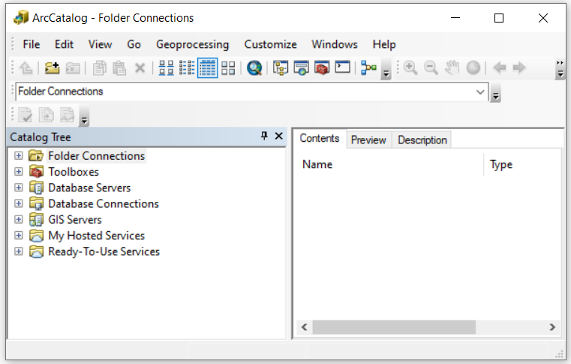
2. ARCCATALOG
ArcCatalog is the program you use to organize and manage various datasets and documents in ArcGIS. This program allows you browse, search, discover view, manage and administer datasets in ArcGIS. It is the equivalent of windows explorer.
How to open ArcCatalog
Click the Start button on the Windows taskbar.
Point to Programs.
Point to ArcGIS.
Click ArcCatalog
ArcCatalog

Slide 10
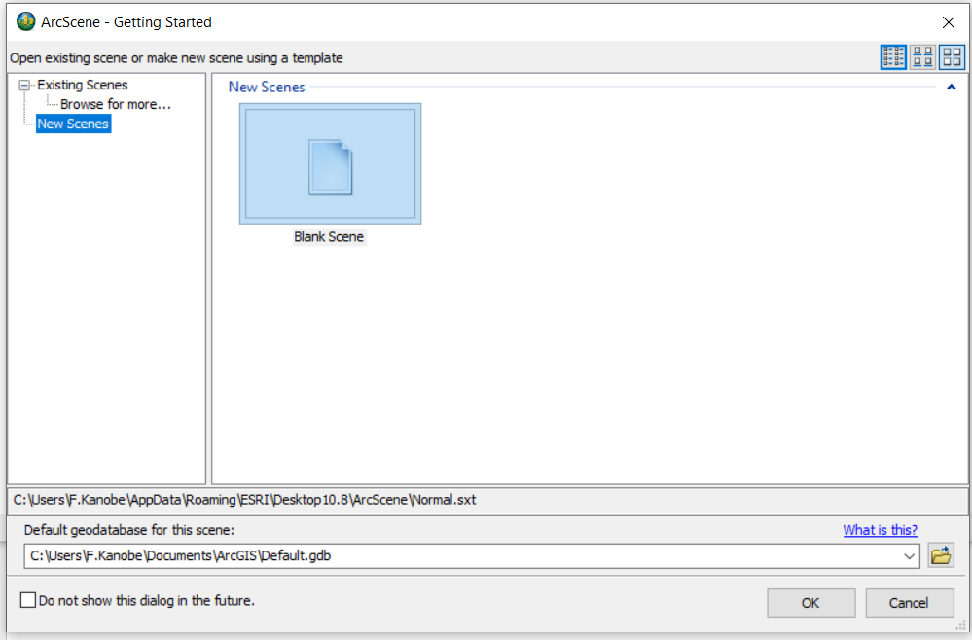
3. ARCSCENE
ArcScene is a 3D visualization application that allows you to view your GIS data in three dimensions. ArcScene allows you to overlay many layers of data in a 3D environment.
How to open ArcScene
Click the Start button on the Windows taskbar.
Point to Programs.
Point to ArcGIS.
Click ArcScene

Slide 11
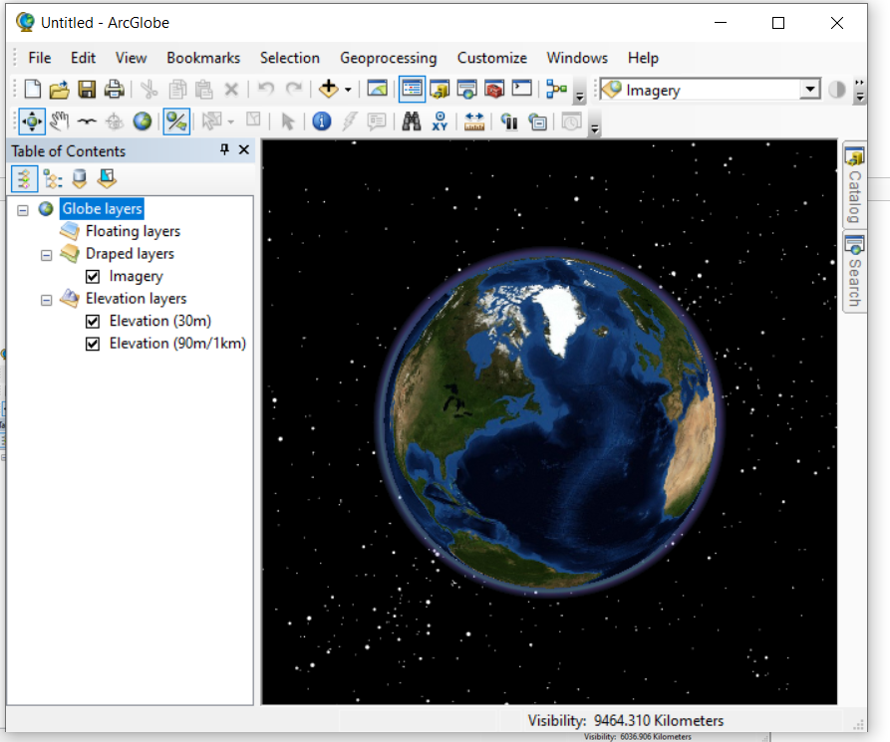
4. ARCGLOBE
ArcGlobe is a 3D visualization application that allows you to view large amounts of GIS data on a globe surface. ArcGlobe provides a new and unique way to view and analyze your GIS data. Spatially referenced data is placed on a 3D globe surface, displayed in its true geodetic location.
How to open ArcGlobe
Click the Start button on the Windows taskbar.
Point to Programs.
Point to ArcGIS.
Click ArcGlobe
ArcGlobe

Slide 12
ESSENTIAL TERMS TO KNOW IN ARCMAP
Layer
A map layer defines how a GIS dataset is symbolized and labeled in your map views. Each layer represents geographic data in ArcMap such as a particular theme of data. Example map layers include streams and lakes, terrain, roads, political boundaries, parcels, building footprints, utility lines etc. Layers can have different features that can be used differentiate them for example:
Point (e.g., buildings, landmarks). Zero-dimensional.
Line, or arc (e.g., roads and streets, streams, railroads, power lines). One-dimensional.
Polygon (e.g., political entities, census geographies such as tracts). Two-dimensional.
Raster images (e.g., an aerial photograph, scanned topographic map, or an elevation model).
Table of contents
The table of contents lists all the layers on the map and shows what the features in each layer represent. The check box next to each layer indicates whether its display is currently turned on or off. The order of layers within the table of contents specifies their drawing order in the data frame from bottom to top

Slide 13
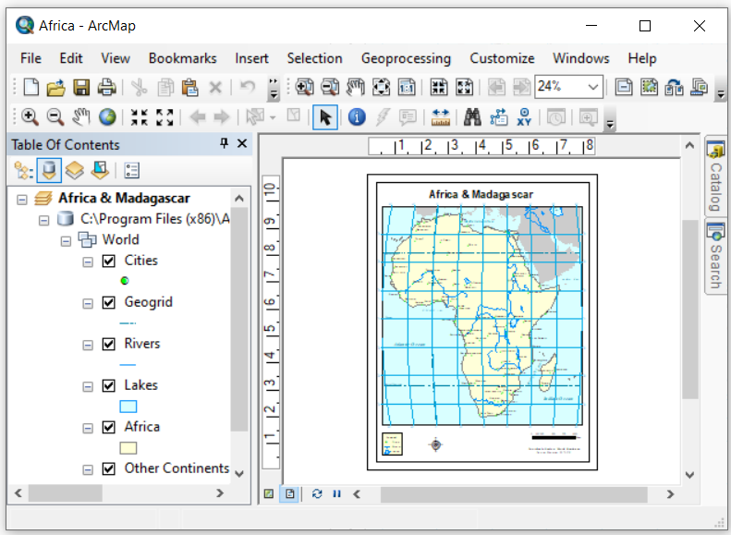
Table of Contents

Slide 14
Labels
Labels are text strings that are used to label features within map layers. Properties define the attribute column used as the source of the text string and how the label is portrayed in your map.
Basemap
A collection of GIS data that form the background setting for a map. The function of the basemap is to provide background detail necessary to orient the location of the map. Typical GIS data make up the layers for a basemap: streets, boundaries, waterways, and aerial or satellite images.
Theme – IS a single layer of data for example Housing
View - is a collection of themes

Slide 15
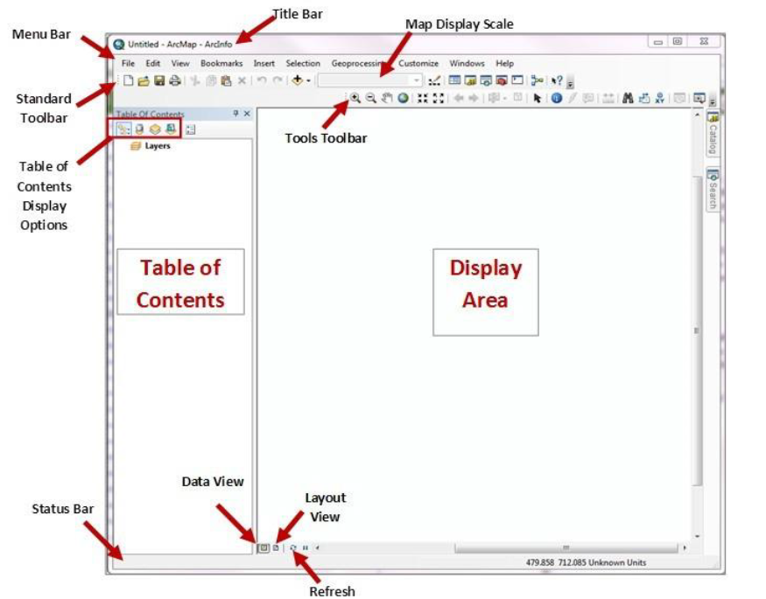
ArcMap Interface
Catalog
Search

Slide 16
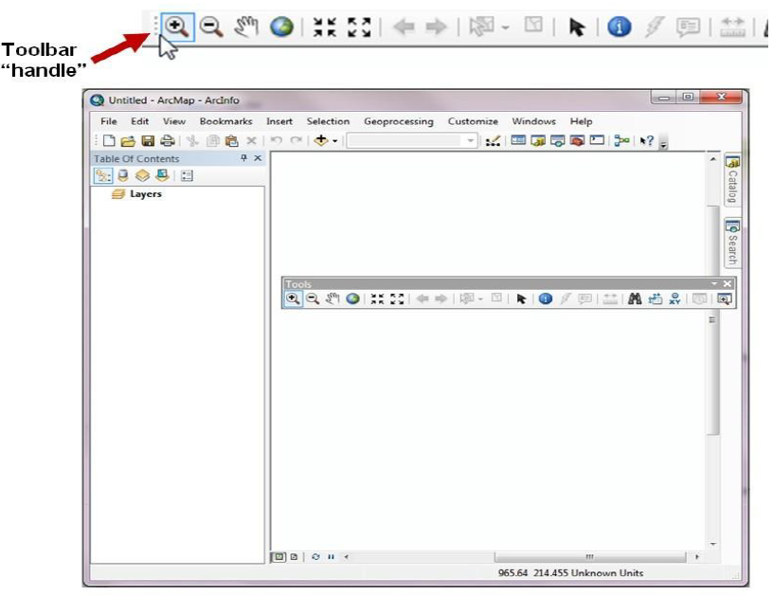
ArcMap Interface
The ArcMap interface is composed several tool bars such as the standard tool bar, tools tool bar etc. Each tool bar perform a number of functions. Use your mouse to point to each of the icons on the tool bars to discover their functions.
Feel free to drag the tool bar and place it any position of your convenience.

Slide 17
Description of the Key Interface items of ArcMap
Menu Bar – Displays all items of the main menu of the application such File, Edit, Bookmarks ….
Table of contents – Used as a panel to display different layers. The table of contents can also be displayed from Windows n the main menu, so is the Catalog and Search. Note that Catalog can be opened in a separate Window but it is convenient to access it via ArcMap. The catalog is helpful when one want to connect or access contents from different folders with ease.
To open files using Catalog, simply navigate to the file you want to open and drag it into the ArcMap display area.
The search panel on Windows is very useful for searching for tools used in ArcMap. However, for new users of the application, it may not be of great importance because one does not know what to search. It is advisable that new users of the application use the tool box to explore the tools or functions within the system.

Slide 18


